Slide 1
WFNJ Funded Services AOSOS NextGen Meeting
December 2025

Slide 2
Meeting Goal
The following slides are examples of what a Workforce Development Local Area might use to report a WorkFirst New Jersey enrollment in the NextGen operating system.
As always, Local Areas should utilize New Jersey Department of Labor and Workforce Development (LWD) resources, as well as established local area policies and procedures.
The following slides are not intended to supplant existing or future federal, State LWD, or Local Area instructions.

Slide 3
Preliminary Steps
Clear Cache/Cookies
Check for an existing record
FAMIS Interface (record came from another system)
CSSA Referral or IAR (highly recommended)
Programs-Public Assistance (PA) tab
AOSOS/NextGen, Staff, News tab
EEO Activity
Achievement Objective (highly recommended)

Slide 4
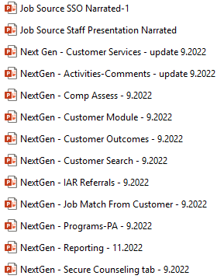

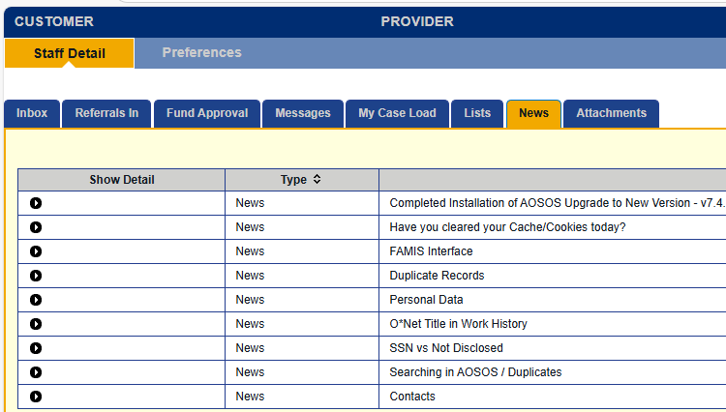
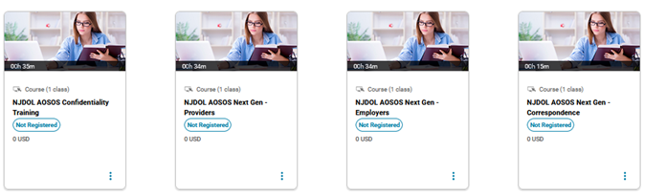
Resources – References and Links
Department of Labor Resources – www.gseta.org
Department of Labor & Workforce Development | Technical Assistance and Reference Materials
NextGen News tab https://jobsource.nj.gov/ptr/Staff/staffdetail.jsf;
Learning Management System (LMS) Videos

Slide 5
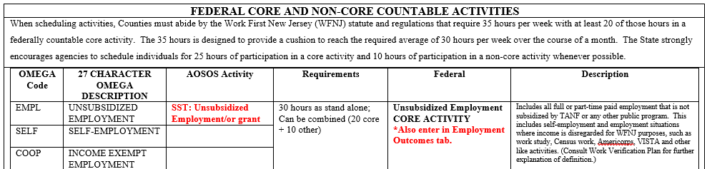
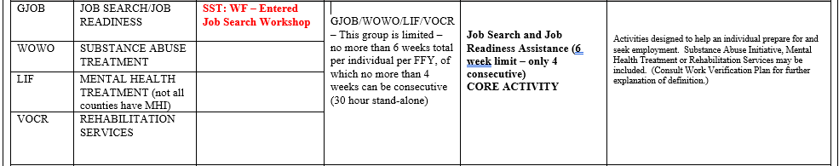
Countable Activities and SST (Seeker Service Type)
The Requirements may dictate the Actual Start Date and Planned End Date of the funded service enrollment.

Slide 6
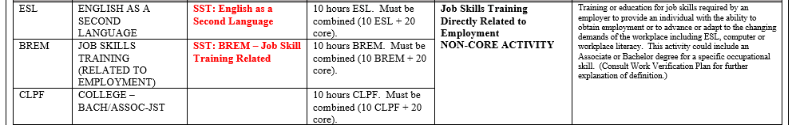
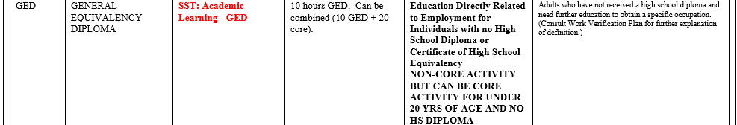
Countable Activities and SST (continued)

Slide 7
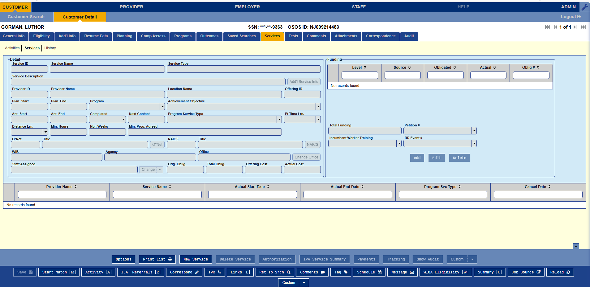

Entering a SNAP Funded Service
Information needed:
IAR
Validated SS#
Individual Employment Plan (IEP)
Provider Offering number
Funding source (i.e., TANF, SNAP)
Start Date and Planned End Date
Program Service Type
Click the New Service button

Slide 8
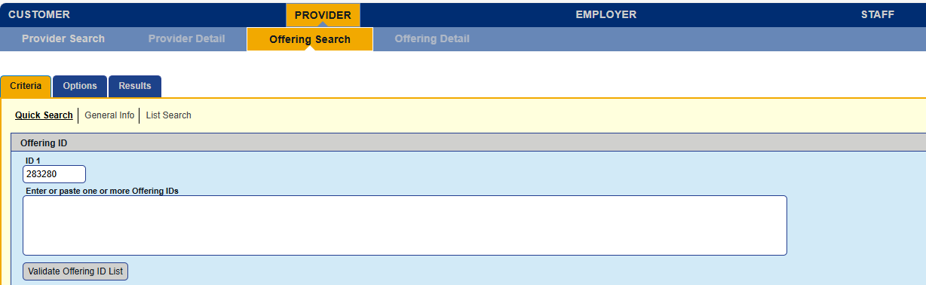
Select the Provider Offering
Enter the 5-digit Offering code that identifies the provider and service
Click on the Search button at the bottom of the screen

Slide 9
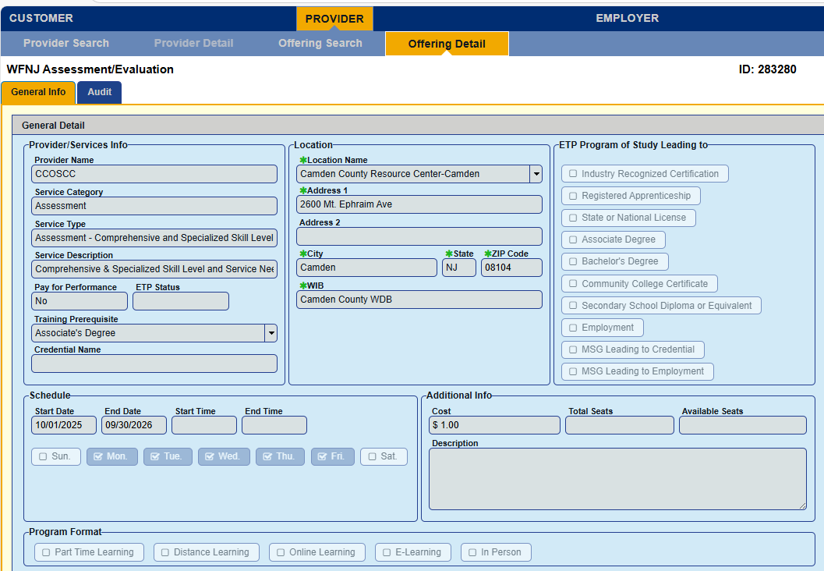
Review the Offering
If the Offering is correct, click Schedule at the bottom of the screen.

Slide 10
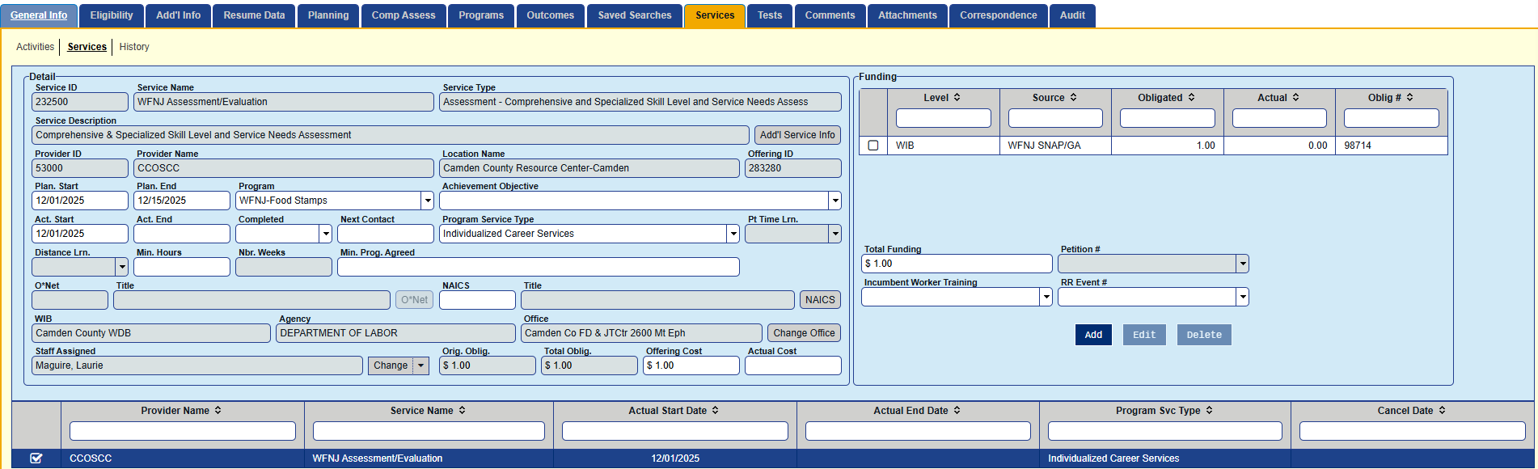
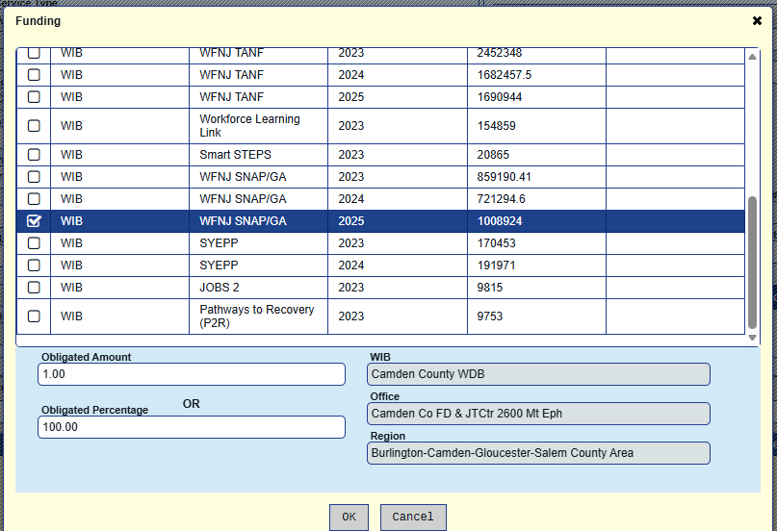
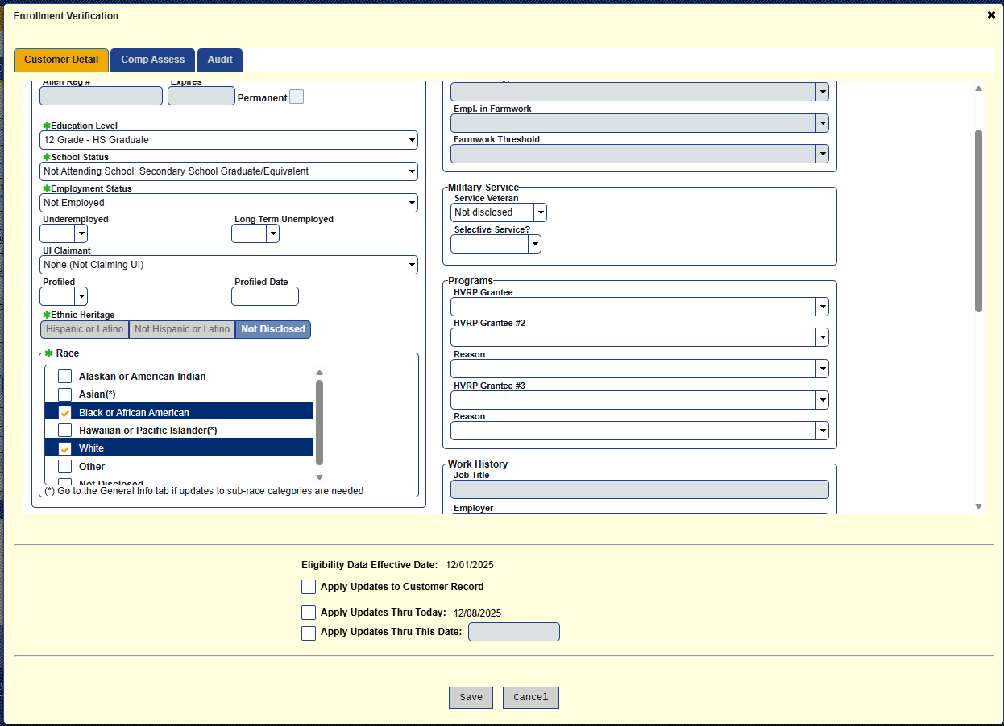
Enter Additional Information
Select the appropriate
Program Service Type:
Basic Career Services-(Staff Assisted),
Individualized Career Services,
ITA Training,
Non-ITA Training
Once the funding is selected and the OK button is clicked, another pop-up will prompt to check the characteristics. More information is available on this step in NextGen – Programs-PA

Slide 11
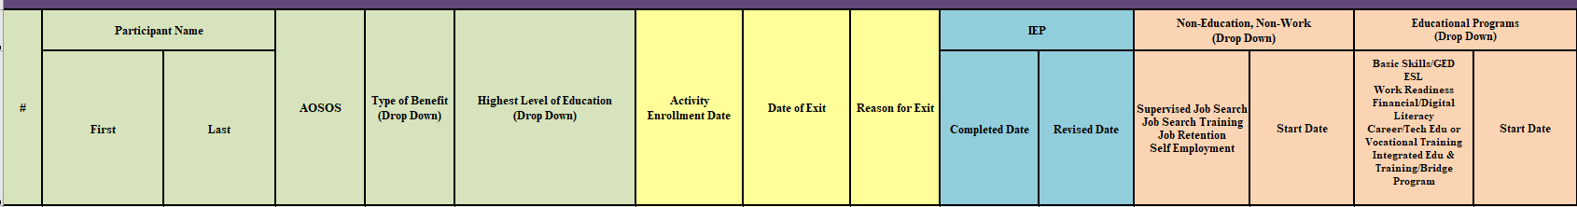
WFNJ Dashboard
SNAP-GA Master tab
After the Offering is funded, the participant must be placed on the WFNJ Dashboard,
SNAP-GA Master, as currently required (Field entries reflect the prior screen SNAP enrollment and may not apply to other records)

Slide 12



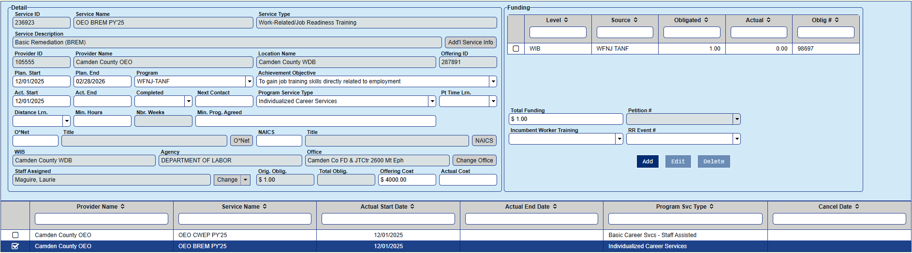
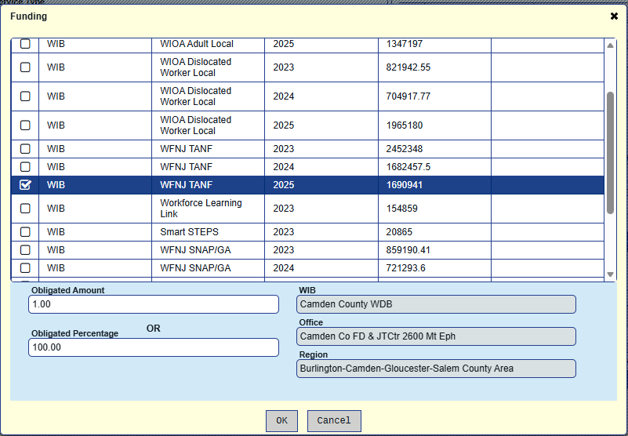
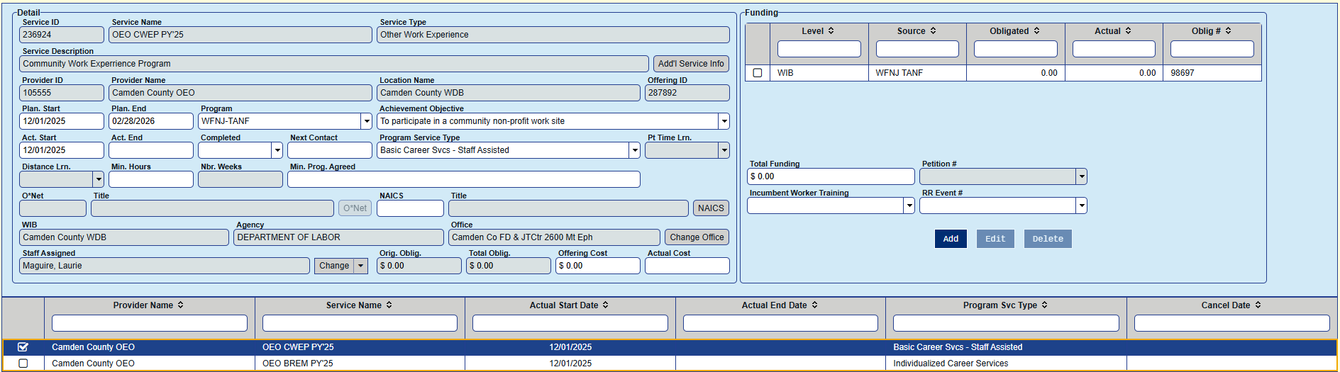
Entering a TANF Funded Service:
What is the difference?

Slide 13
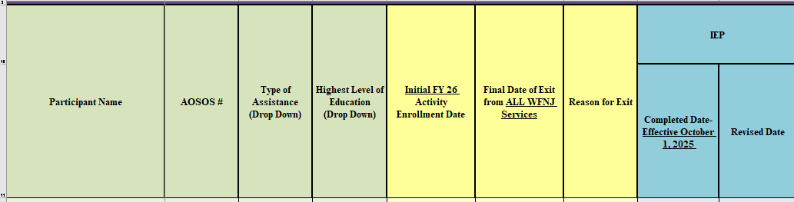
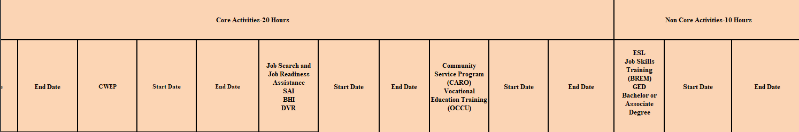
WFNJ Dashboard
TANF Master tab
After the Offering is funded, the participant must be placed on the WFNJ Dashboard,
TANF Master, as currently required (Field entries reflect the prior screen TANF enrollment and may not apply to other records)

Slide 14

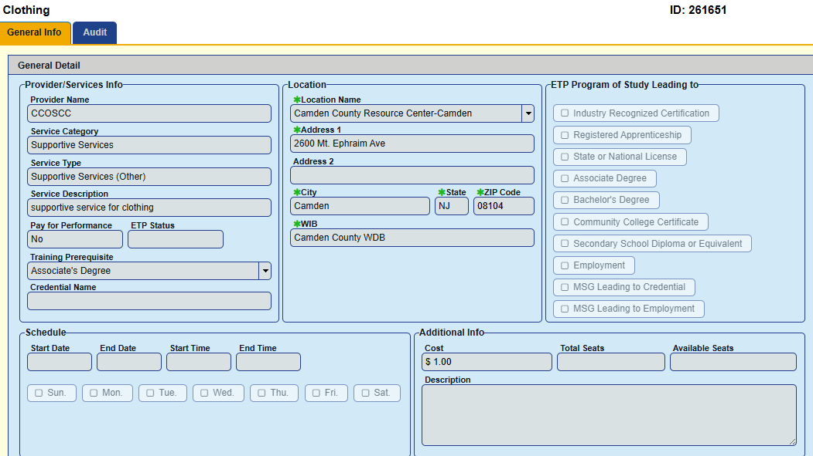
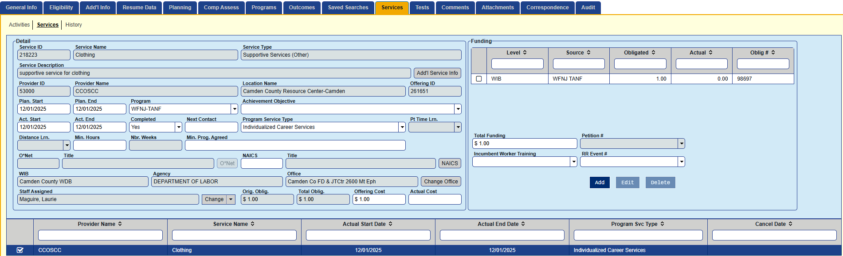
Supportive Services
Enrollments for supportive services should reflect a one-day event and might include services such as Transportation, Books & Materials, Credentials, Fees, Supplies and Tools, as defined and approved by the Local Area policies and procedures.

Slide 15
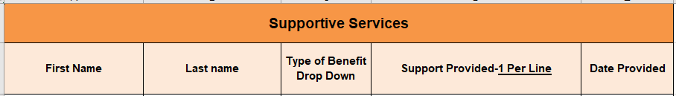
WFNJ Dashboard
SNAP or TANF
After the Offering is funded, the participant must be placed on the WFNJ Dashboard,
Supportive Services tab, as currently required (Field entries reflect the prior screen Supportive Service enrollment and may not apply to other records)

Slide 16
Questions?

